Slide 1
US WildFires (1992-2015)
Bassam Aziz, Noor Habib, Lei Sabarre, Sam Struthers
Notes:
Queue gordan ramsey fire song

Slide 2
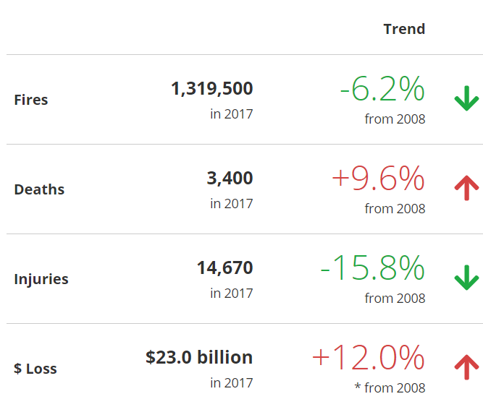
Motivation/Summary
Recent notable fires
We live in a frequent fire state >
Stats from FEMA 2008-2017
Is there a correlation between…?
Trends in size/frequency YOY
Fire cause and size/frequency of fires
State and cause/size/frequency
We found some strong correlations when
looking at sizes of fires but not strong enough
to prove causation
Notes:
Sam
Increase in average size of fires YOY
Lightning is biggest contributor to fire size
West Coast has the most notable fires over 15K acres
2015 is the most recent year of data - limiter

Slide 3
Questions & Data
Is count or size of fires more significant?
Broad US data…?
Is there a consistent top cause of fire?
Are there causes that result primarily in the largest fires?
State data…?
Are there any states that have trends YOY?
Which combinations of data have strong trends?
Notes:
Noor –
We only kept 9 columns of data our of 39 in the file to actually analyze
While the count of fires decreased, their size increased as a US average YOY – our next slide visualizes this
There was a main contributor to both fire size AND frequency
there are states that have stronger YOY trends

Slide 4
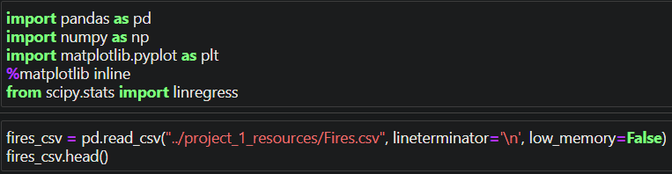
Data Cleanup & Exploration
CSV file – 23 years of fire data for the US – missing data
Short, Karen C. 2017. Spatial wildfire occurrence data for the United States, 1992-2015 [FPA_FOD_20170508]. 4th Edition. Fort Collins, CO: Forest Service Research Data Archive. https://doi.org/10.2737/RDS-2013-0009.4
Unusable rows – drop N/A
39 data points => 9 data points
JN helped navigate almost 1 million lines of data
Notes:
Sam

Slide 5
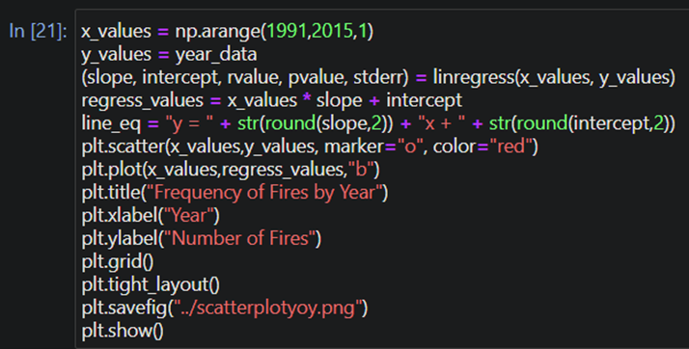
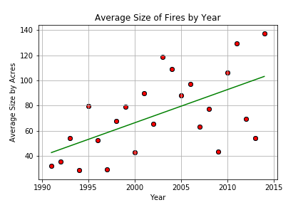
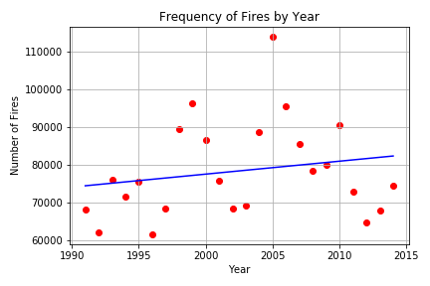
Data Analysis
Notes:
Sam

Slide 6
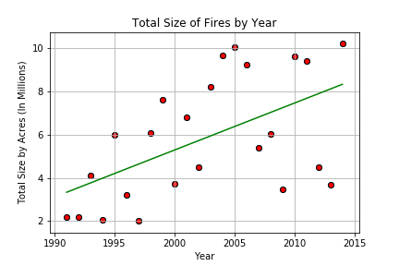
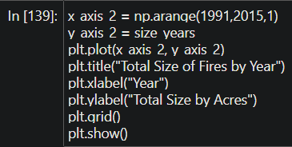
Data Analysis
Notes:
Sam

Slide 7
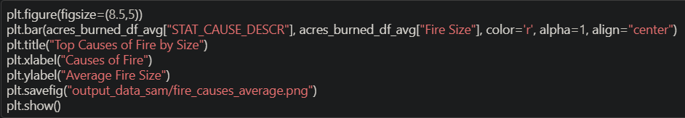
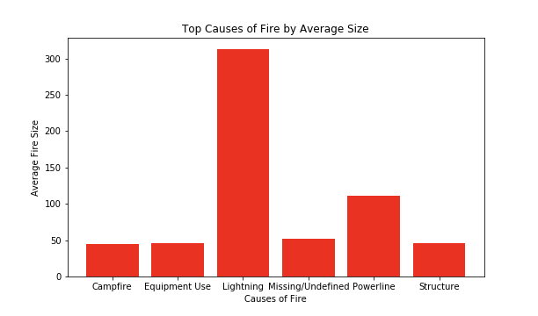
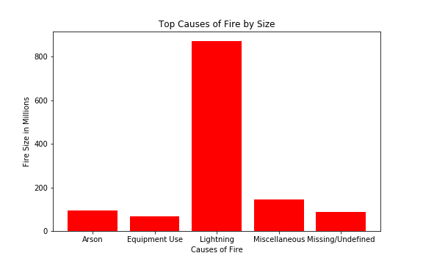
Data Analysis
Notes:
Bassam

Slide 8
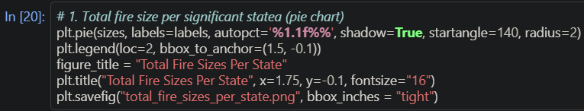
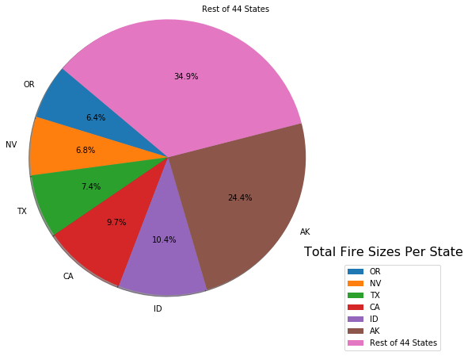
Data Analysis
Notes:
Lei

Slide 9
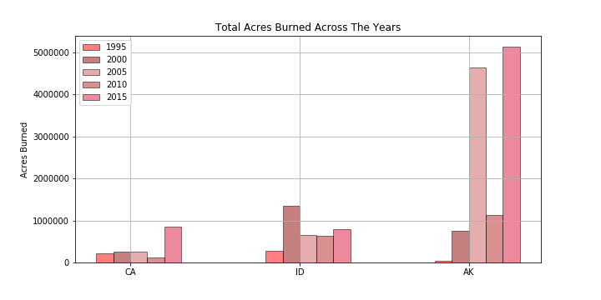
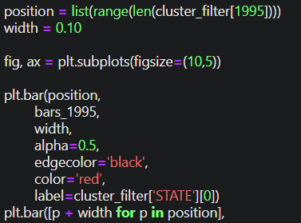
Data Analysis
Notes:
Lei

Slide 10
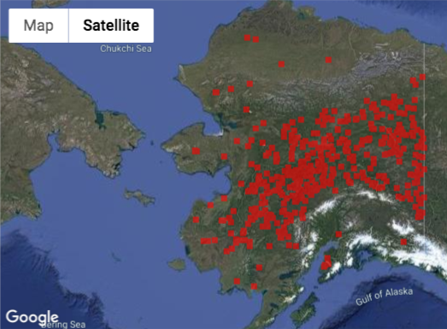
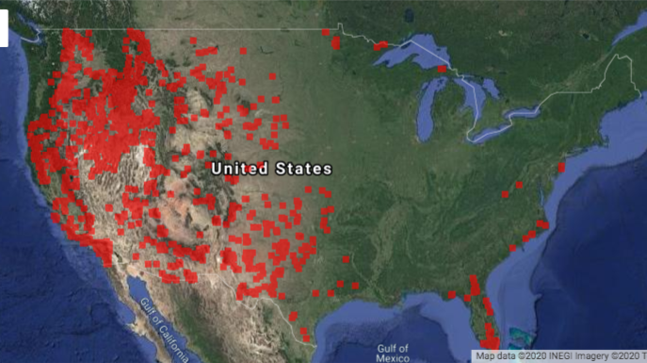
Data Analysis
Notes:
Bassam

Slide 11
Discussion/Post Mortem
Visualization – Jupyter Notebook
The data needed special encoding
Filtering thru the full file and slicing and dicing states for more concise comparisons were tedious
Notes:
Noor –
Data limitations within data set
Limitations on data – exploration – wish list

Slide 12
Questions

